Slide 1
Introduction to
The AMOS Project
Dirk Riehle, Univ. Erlangen
AMOS A01
Licensed under CC BY 4.0 International

Slide 2
Course Goals 1 / 2 [1] [2] [3] [4]
To introduce students to agile methods by creating useful open- source software in a team
[1] Professional = ambition + collaboration with external partner
[2] Agile methods = our focus here, specifically Scrum + XP
[3] We teach both overall processes as well as best practices
[4] Useful software is software that has value to someone!

Slide 3
Course Goals 2 / 2
Learning objectives
Gain conceptual understanding and practical skills of using
agile software development methods
software project management tools
software development tools
Learn how to work
with an external stakeholder
in a (student) project team
Project objectives
Develop useful open-source software
Perform a great demo on demo-day!

Slide 4

Industry Partners

Slide 5
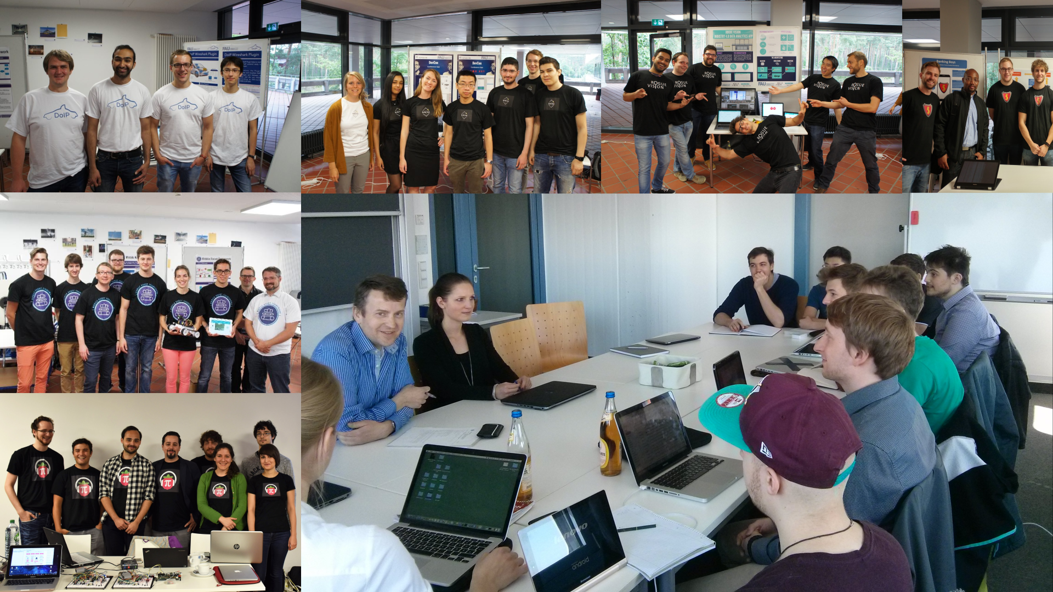

Slide 6
Skills Required for Course
General skills
Willingness and ability to work in a team
Ability to acquire skills during the project
Role-specific skills
Product owner (PO) role
Strong conceptual thinking, ability to communicate well, affinity to technology
Software developer (SD) role
Technology (specific to project), development tools like git, test-driven development
Scrum Master (SM) role
Past successful experience as an AMOS product owner or software developer

Slide 7
Structure and Content of Course
See course organization at https://amos.uni1.de

Slide 8
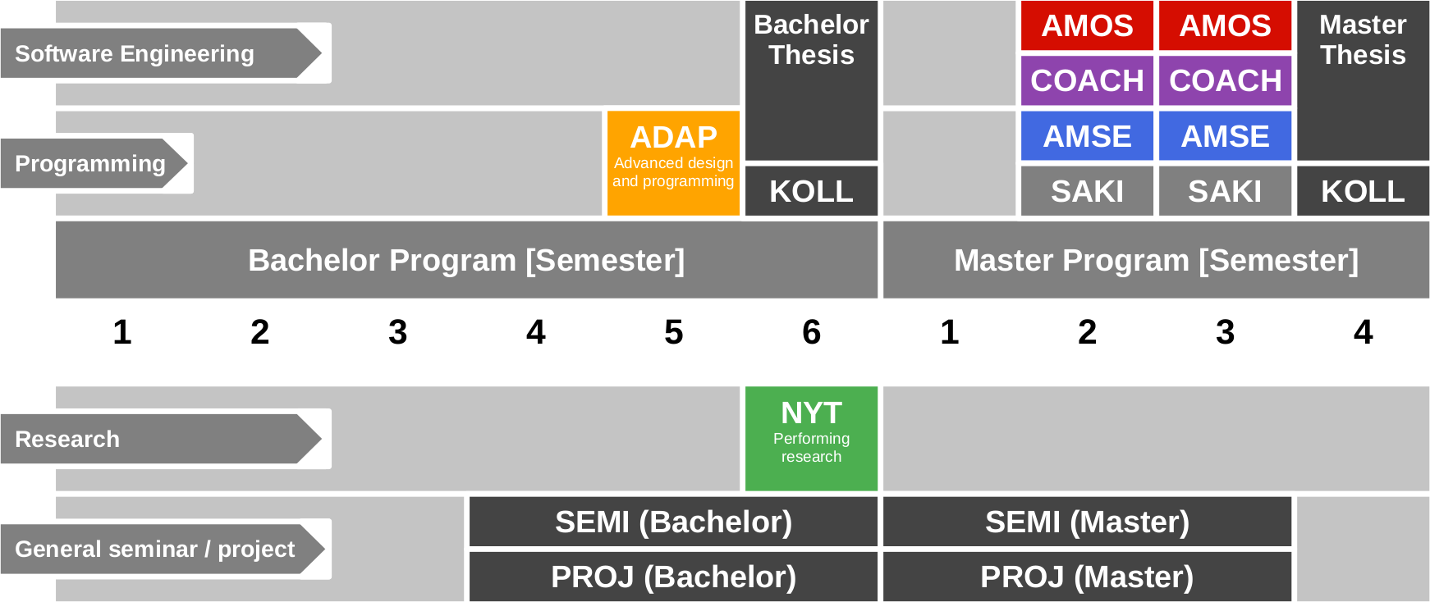
Course Position in Curriculum

Slide 9
Modules and Courses
 |  | Courses (Lehrveranstaltungen)
 |  | AMOS-VL | AMOS-UE (Team Meeting) | COACH-VL | Total ECTS
Modules | AMOS-PO | x | x | – | 5
 | AMOS-SD | x | x | – | 9 / 10
 | AMOS-SM | + | x | x | 3
 | COACH | + | x | x | 5

Slide 10
Availability of Modules
 |  | University
 |  | Univ. Erlangen | TU Berlin | FU Berlin
Modules | AMOS-PO | x | – | –
 | AMOS-SD | x | x | x
 | AMOS-SM | – | x | –
 | COACH | x | – | –

Slide 11
Course Grading [1] by Role (Module)
Product Owner (AMOS-PO)
Theory (lectures) = 20% of grade
2 SWS in 5 ECTS = 20%
As measured by class quizzes
Grading scale is [0..10] points
Practice (project) = 80% of grade
Contribution to teamwork = 50%
As measured in team meetings
Grading scale is [0|1|2|3]
Independent work = 50%
As measured by artifacts
Grading scale is [0|1|2|3]
Software Developer (AMOS-SD)
Theory (lectures) = 10% of grade
2 SWS in 10 ECTS = 10%
As measured by class quizzes
Grading scale is [0..10] points
Practice (project) = 90% of grade
Contribution to teamwork = 50%
As measured in team meetings
Grading scale is [0|1|2|3]
Independent work = 50%
As measured by artifacts
Grading scale is [0|1|2|3]
[1] Also see http://oss.cs.fau.de/teaching/course-resources/grading-schemes-and-scales/

Slide 12
Scrum Master (COACH / AMOS-SM)
Scrum Master (AMOS-SM)
Grading is handled in separate 5-ECTS course COACH / AMOS-SM
The Scrum Master leads process improvement / questions
The Scrum Master does not represent the teaching team
They do not handle student performance questions

Slide 13
Class Quizzes
Each class session starts with a class quiz
A quiz will test your understanding of last session’s topic
A quiz typically has 5 questions and will last 10 minutes
The overall quiz is graded using [0..10] scheme (10 points in total)
A class quiz will open precisely when class starts
The quiz is administered automatically
It is your job to have reliable Internet access etc.
There is no way to make up for a missed quiz

Slide 14
Project Work Grading
We grade by deliverables, see homework document, including
Regular deliverables (product backlog, code contributions, …) every sprint
Irregular (one-time) deliverables as they happen
We also grade anyone’s individual teamwork contribution when
We are present in the team meetings, usually sprint 3, 5, 7, 10, and 13
Our expectations are explained in class and documented as the
Capabilities timeline and the
Capabilities timeline explanation

Slide 15
Collaboration and Grading
We (have to) grade you individually
If you collaborate, for example,
by pair programming
by pair designing
you agree to be graded jointly

Slide 16

Major Milestones
Build process review (quality gate)
You are expected to demo a well working build process
If you fail, you will be put on notice
Mid-project review (quality gate)
You are expected to demonstrate your work
If you fail, you may lose your industry partner
Final project release and demo day

Slide 17
Team Issues
We grade your individual performance, not the team performance
A great team motivates everyone, increases productivity
Encourage slackers to improve and don’t cover for them
The Scrum master is responsible for resolving process impediments

Slide 18
The AMOS Consultancy
You can ask questions using the AMOS course channel on Slack [1] at
https://join.slack.com/t/amosproj/signup
There is no downside to asking questions (no malus)
Quality answers will afford a bonus to the answering student
[1] We expect to move to an open source solution but aren’t there yet

Slide 19
Course Registration vs. Exam Registration
Step 1: Course registration (German: Kursanmeldung)
Students sign up through the course management system
You may or may not get in, various rules and regulations apply
The earlier you sign up, the more likely you are to get in
Step 2: Exam registration (German: Prüfungsanmeldung)
During the first weeks of the course, you can decide to drop out
Four weeks (or so) into the semester, you can register for the exam
After exam registration closes, your decision is binding

Slide 20
Receiving a Grade for the Course
If you want to receive a grade
You must register through your university’s exam registration system
Your degree program may have split the course into two (VL + UE)
Please check asap that the course is available in your degree program!
In case of problems, please see
https://oss.cs.fau.de/teaching/course-resources/course-registration/
Otherwise: No grade

Slide 21

No Oral or Written Exam [1] [2]
[1] If both you and we don’t want to
[2] You still have to register for the course

Slide 22
Course Language [1]
Class
Lecturer: English
Student: Choice of German or English
Project
Instructor: English
Team: Choice of German or English
[1] See https://oss.cs.fau.de/2012/03/10/english-or-german-deutsch-oder-englisch/

Slide 23
Course Organization
Course organization
See https://amos.uni1.de
Course schedule
See Schedule tab on Course Organization doc
Project descriptions
See Project Descriptions on Course Organization doc
Project teams
See Project Teams tab on Course Organization doc

Slide 24
Work Rhythm
Lectures
Class day (90min.)
Team meetings
Next slot after lecture
Project work (self-organized)
Deliverables due according to schedule

Slide 25
Course Communication
Announcements are sent by email
Through email aliases
Through course management system
Administrative questions to teaching team
Please ask your question in the course forum
For private questions, use the teaching team email alias

Slide 26
Thank you! Any questions?
dirk.riehle@fau.de – https://oss.cs.fau.de
dirk@riehle.org – https://dirkriehle.com – @dirkriehle

Slide 27
Legal Notices
License
Licensed under the CC BY 4.0 International license
Copyright
© Copyright 2023 Dirk Riehle, some rights reserved

